Slide 1
Coastal Carolina University
Computer Science Department
Ant Meeks
Pooh Harris
Oliver Pearson
Kevin Chucci
Kelby Martin
Notes:
Three interlocking rings
(Intermediate)
Tip: Some shape effects on this slide are created with the Combine Shapes commands. To access this command, you must add it to the Quick Access Toolbar, located above the File tab. To customize the Quick Access Toolbar, do the following:
Click the arrow next to the Quick Access Toolbar, and then under Customize Quick Access Toolbar click More Commands.
In the PowerPoint Options dialog box, in the Choose commands from list, select All Commands.
In the list of commands, click Combine Shapes, and then click Add.
To reproduce the shape effects on this slide, do the following:
On the Home tab, in the Slides group, click Layout, and then click Blank
Also on the Home tab, in the Drawing group, click Shapes, and then under Basic Shapes click Donut (third row).
Drag to draw a donut on the slide.
Drag the yellow adjustment handle to make the donut thinner.
Select the donut. Under Drawing Tools, on the Format tab, in the Shape Styles group, click Shape Outline, and then click No Outline.
Also on the Format tab, in the Size group, enter 3” into the Height box and 3” in the Width box.
On the Home tab, in the Clipboard group, click the arrow to the right of Copy, and then click Duplicate. Repeat this process once until there are three donuts on the slide.
Select one of the donuts. Under Drawing Tools, on the Format tab, in the Size group, click the Size and Position dialog box launcher. In the Format Shape dialog box, click Position in the left pane, and in the Position pane, under Position on slide, do the following:
In the Horizontal list, enter 3.5”, and then in the From list select Top Left Corner.
In the Vertical list, enter 0.78”, and then in the From list select Top Left Corner.
Select another donuts. Under Drawing Tools, on the Format tab, in the Size group, click the Size and Position dialog box launcher. In the Format Shape dialog box, click Position in the left pane, and in the Position pane, under Position on slide, do the following:
In the Horizontal list, enter 2.21”, and then in the From list select Top Left Corner.
In the Vertical list, enter 2.91”, and then in the From list select Top Left Corner.
Select the last donut. Under Drawing Tools, on the Format tab, in the Size group, click the Size and Position dialog box launcher. In the Format Shape dialog box, click Position in the left pane, and in the Position pane, under Position on slide, do the following:
In the Horizontal list, enter 4.71”, and then in the From list select Top Left Corner.
In the Vertical list, enter 2.91”, and then in the From list select Top Left Corner.
Select all of the ovals. On the Quick Access Toolbar, click Combine Shapes, and then click Shape Union.
Select the new shape. Under Drawing Tools, on the Format tab, in the Shape Styles group, click the Format Shape dialog box launcher. In the Format Shape dialog box, click Fill in the left pane, in the Fill pane, click Gradient fill, and then click the button next to Preset and select Chrome II.
Also in the Format Shape dialog box, click 3-D Format in the left pane, and then in the 3-D Format pane, do the following:
Under Bevel, click the button next to Top and then click Cross.
Also under Bevel, next to Top, In the Width box, enter 8 pt.
Under Depth, click the button next to Color and then click Black, Text 1.
Also under Depth, in the Depth box, enter 12 pt.
Under Surface, click the button next to Lighting, and then under Neutral click Balance.
Also under Surface, in the Angle box, enter 60°.
Also in the Format Shape dialog box, click Shadow in the left pane, and in the Shadow pane, do the following:
Click the button next to Presets, and then under Perspective click Below.
In the Transparency box, enter 45%.
In the Blur box, enter 25 pt.
Also in the Format Shape dialog box, click 3-D Rotation in the left pane, in the 3-D Rotation pane, click the button next to Presets, and then under Perspective, click Perspective Relaxed Moderately.
Also in the Format Shape dialog box, click Size in the left pane, in the Size pane, under Size and rotate, in the Rotation box, enter 15°.
To reproduce the background effects on this slide, do the following:
On the Design tab, in the Background group, click Background Styles, and then click Format Background. In the Format Background dialog box, click Fill in the left pane, select Gradient fill in the Fill pane, and then do the following:
In the Type list, select Radial.
Click the button next to Direction, and then click Center.
Under Gradient stops, click Add gradient stops or Remove gradient stops until three stops appear in the drop-down list.
Also under Gradient stops, customize the gradient stops as follows:
Select the first stop in the slider, and then do the following:
In the Position box, enter 0%.
Click the button next to Color, and then under Theme Colors click White, Background 1, Darker 15%.
Select the next stop in the slider, and then do the following:
In the Stop position box, enter 40%.
Click the button next to Color, and then under Theme Colors click Black, Text 1, Lighter 50%.
Select the last stop in the slider, and then do the following:
In the Stop position box, enter 100%.
Click the button next to Color, and then under Theme Colors click Black, Text 1, Lighter 15%.

Slide 2
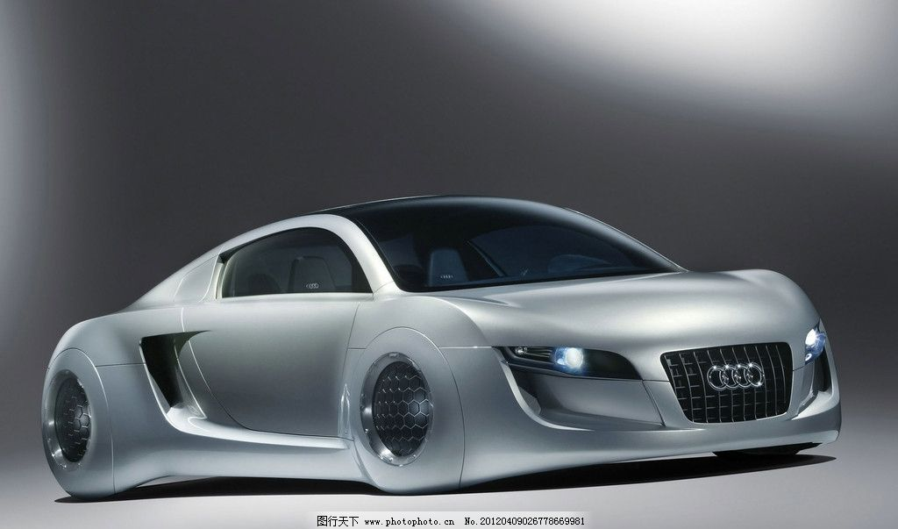
Self-Driving Cars

Slide 3
Thesis Statement
Connected vehicles use formation, integration, deployment, and experimentation for software development.

Slide 4
Abstract
The interconnectivity between constantly updating software and integration of software creates a development environment full of algorithms and abstract data. As time goes on, the software and data used in self-driving cars produce those algorithms as well. The advancement of transportation is related to technology's rate of growth. Defining the testing, updating, and implementing of the software is how autonomous cars are advanced. The use of autonomous vehicles could lower fatal accidents and increase productivity, but with that, could also take jobs away from the people.

Slide 5
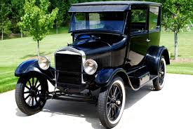
The advancement of creativity
Transportation has an great impact on society
We have come a long way from horses and buggies
The automobile has made an huge advancement
Model-T Ford was the first invented car
Nowadays, cars can drive their-selves

Slide 6
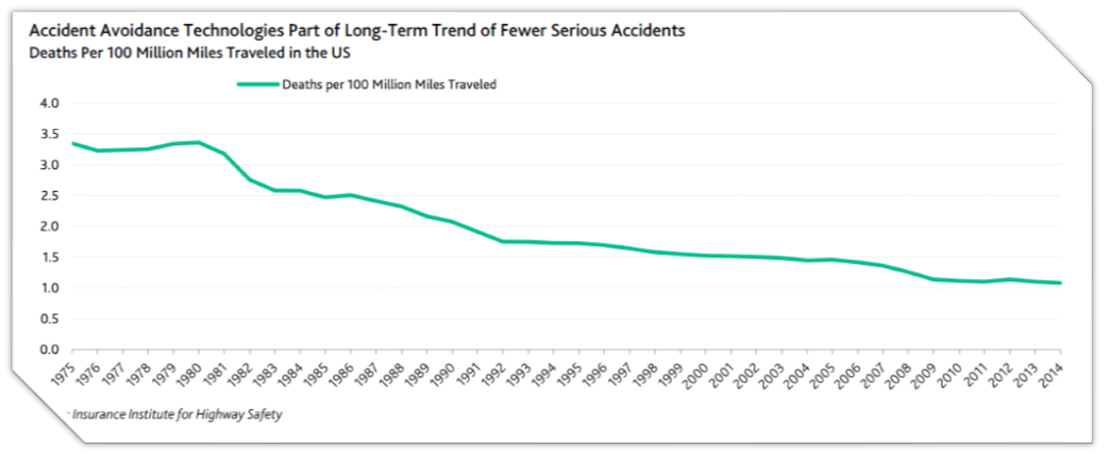
number of accidents

Slide 7
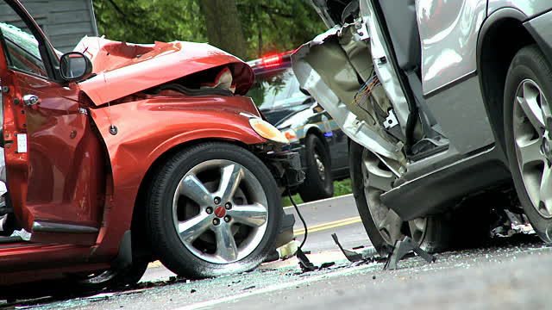
accidents statistics
Deaths by automobile accident: 40,000
Injuries by automobile: 1,900,000
Total casualties: 2,000,000

Slide 8
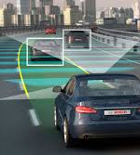
safer because....
Not a car for every person
A car for every location
More parking spots
No more traffic jams

Slide 9
Benefits
Reduced Aggressive Driving 82%
Saving on Car Insurance 80%
New Mobility Options for people with Disabilities 78%
Better Fuel Efficiency
Fewer traffic collisions

Slide 10




Some self-driving cars include......

Slide 11
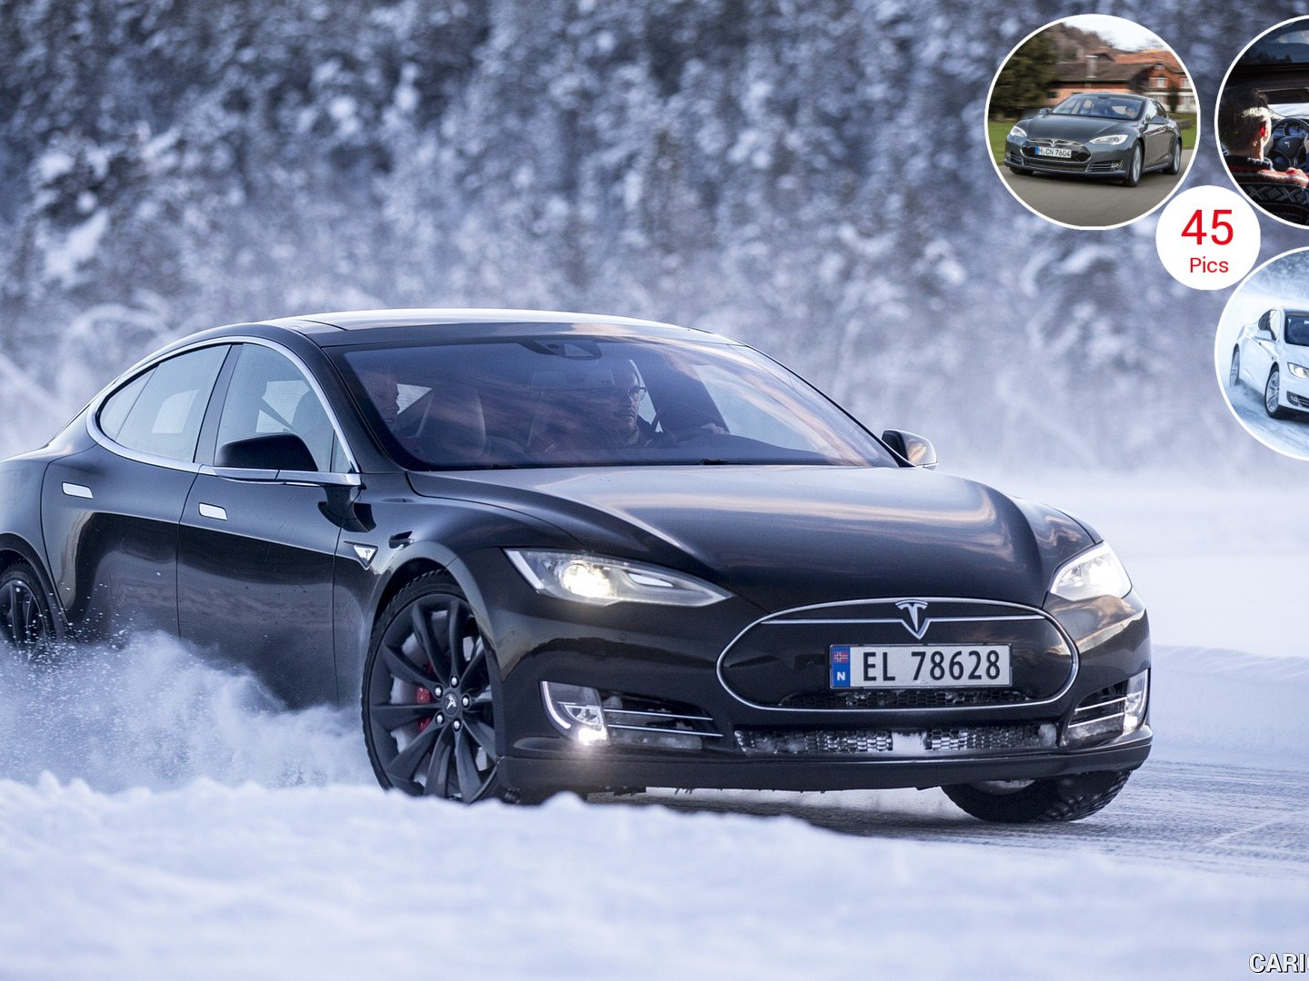
Tesla
Full Self-Driving Capability
8 cameras provides 360 view
Allows you to see through:
Snow
Rain
Fog
Smoke

Slide 12
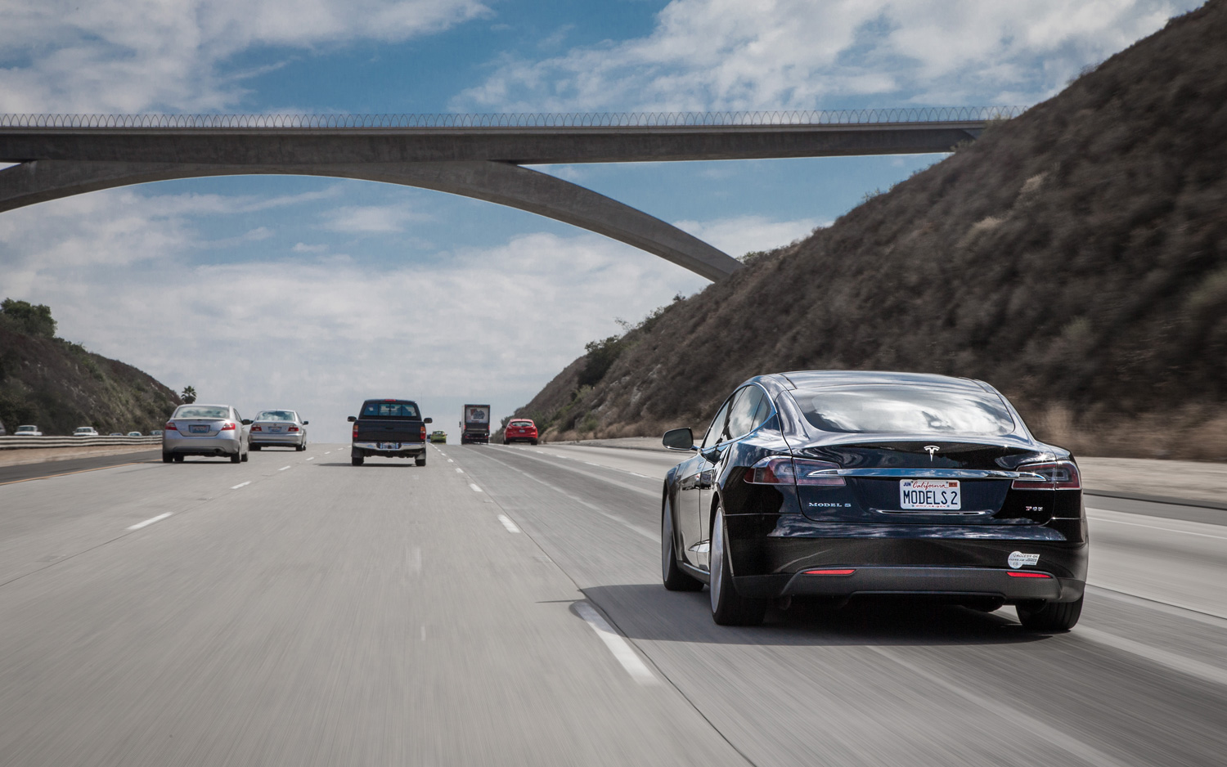
Make lanes changes
Match speed conditions
Exit the freeway
Park itself

Slide 13
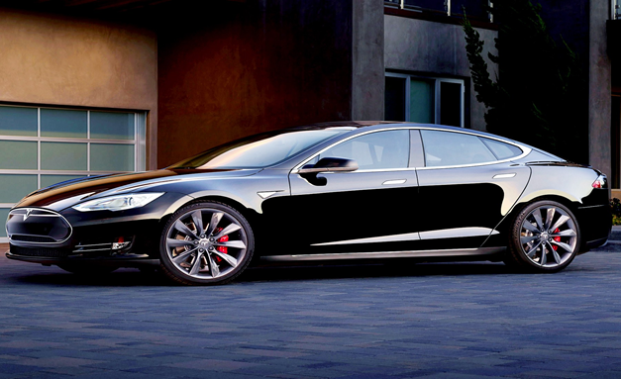
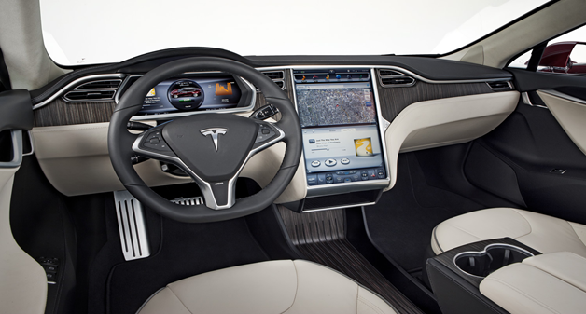
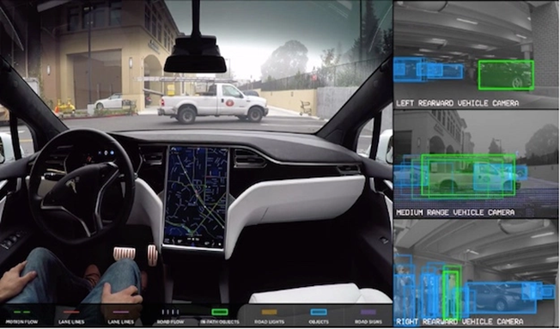
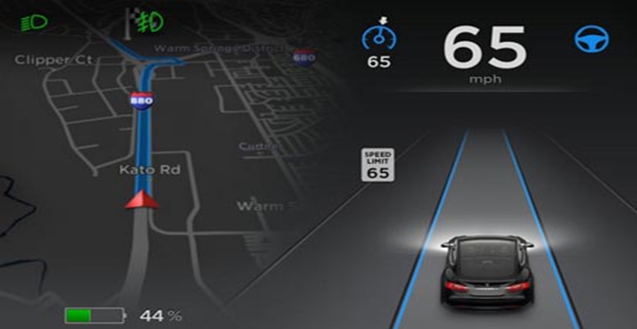

Slide 14

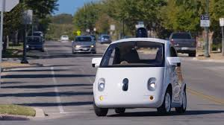
waymo
sensors that detect things
Understands a pedestrians movements
Always alert and never distracted
Cars know how to navigate through traffic

Slide 15
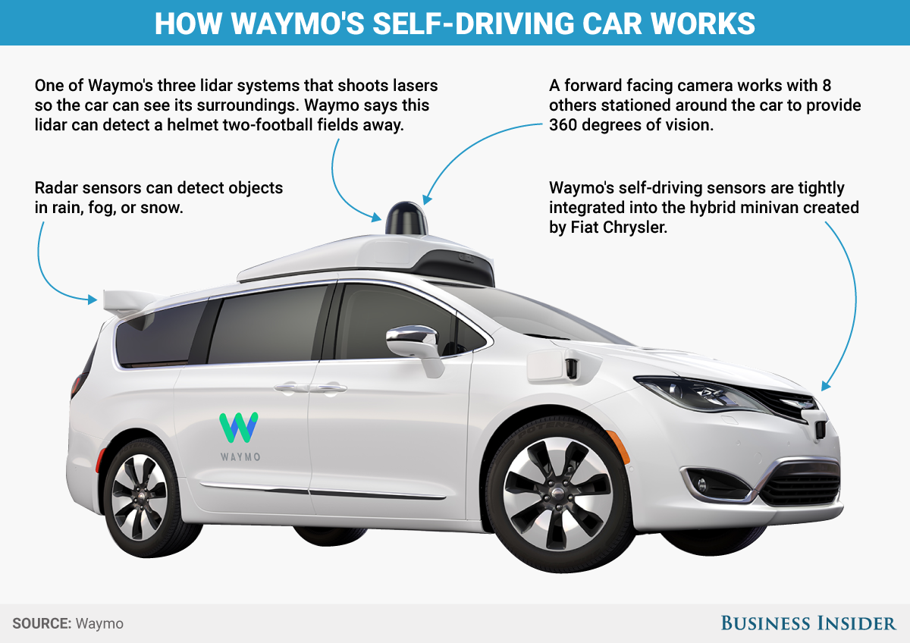

Slide 16
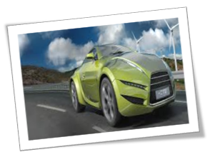
Te connectivity
Fully electric car
Uses data connectivity
Collision avoidance
Headlights to help you see the road

Slide 17
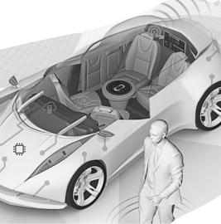
Intel
Works on building trust with the passenger
Over the air updates
Hd-video entertainment
5g connectivity

Slide 18
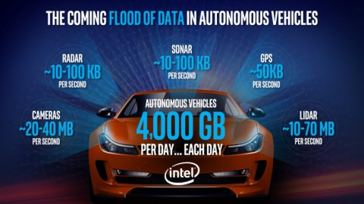
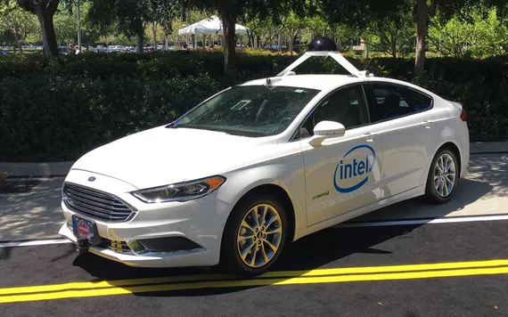

Slide 19
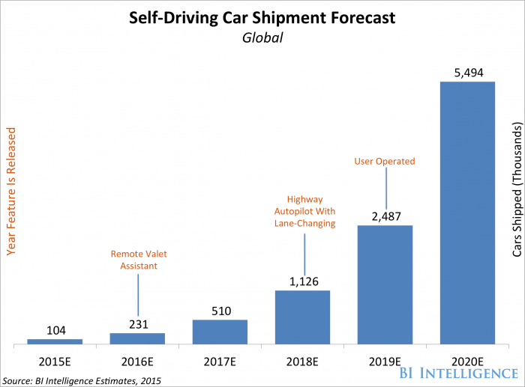

Slide 20
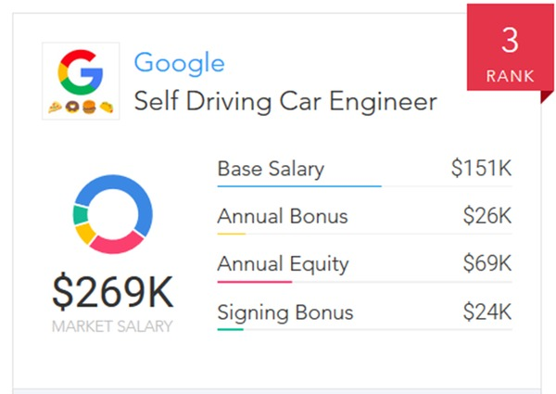
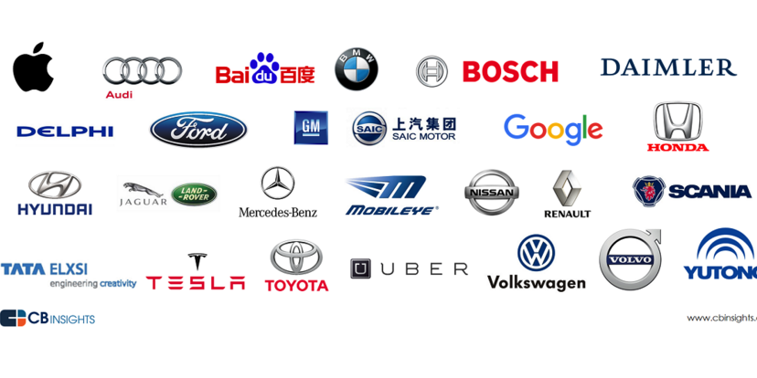
Incentive for engineers
Players

Slide 21
Bibliography
Autonomous Driving is Powered by Intel (2017, September 19). Next Era of Driving Is Here. Retrieved from https://www.intel.com/content/www/us/en/automotiv/autonomousvehicles.html
Autopilot (2017, September 19). Autopilot. Retrieved from https://www.tesla.com/autopilot.
Waymo. September 19, 2017 We’re building a Safer Driving for Everyone. Retrieved from https://waymo.com/
TE Connectivity. September 19, 2017 The Future of the Electric Car is Autonomous. Retrieved from http://www.te.com/usa-en/about-te/ecc/awesome-electric-vehicles.html

Slide 22
Internet Applications
Testing modules’ behavior
Computation for additional software
Connectivity makes autopilot driving possible
Vulnerable to hacking if online
-Disabling brakes

Slide 23
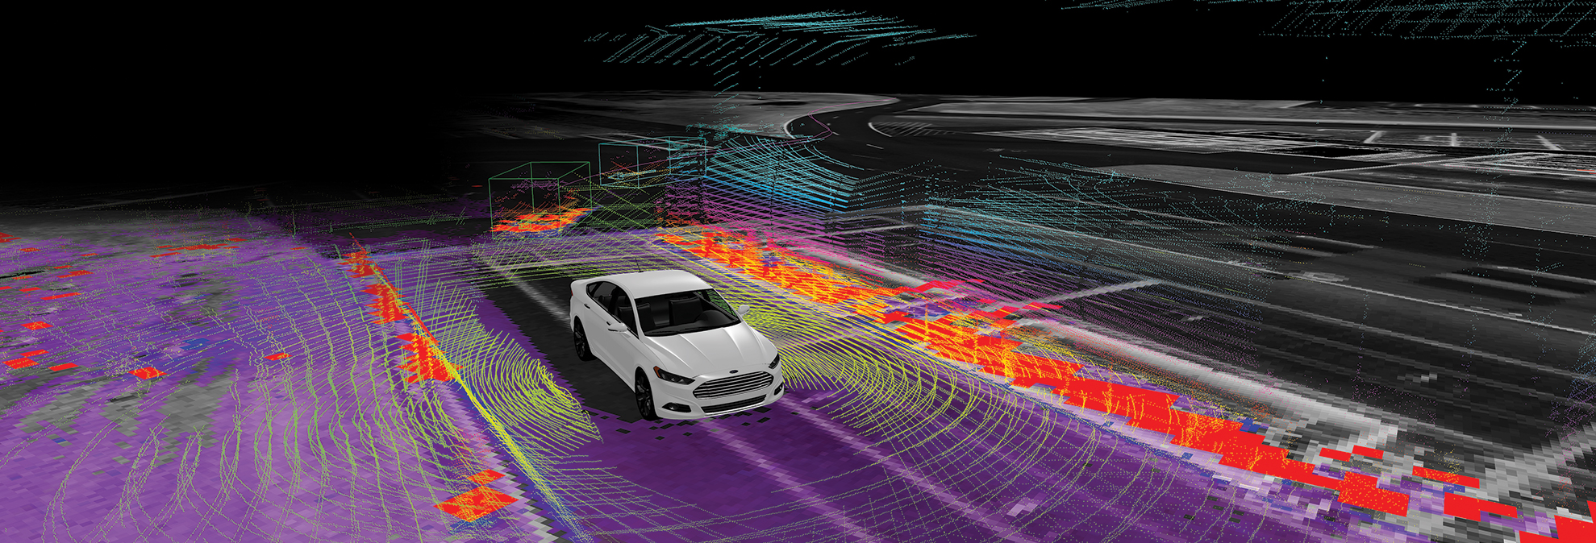
Data
- Radar sensors
- Video cameras
- Ultrasonic sensors Lidar (Light detection and ranging)
- GPS (global positioning system)
- a central computer.
- Continuous experimentation

Slide 24
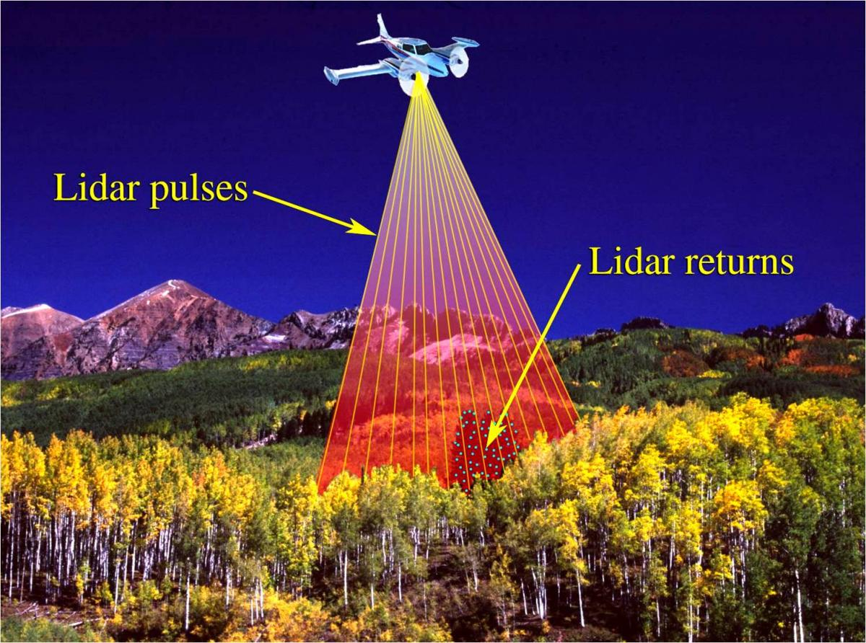

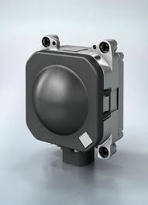
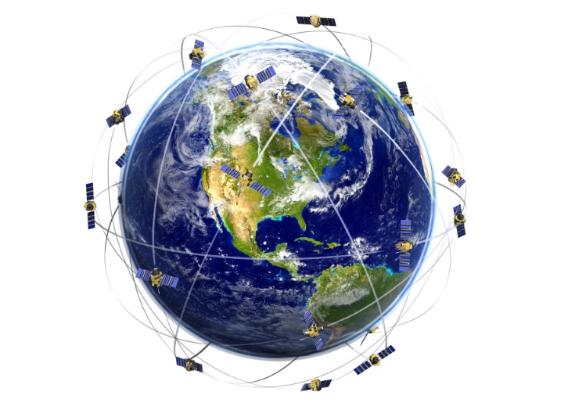
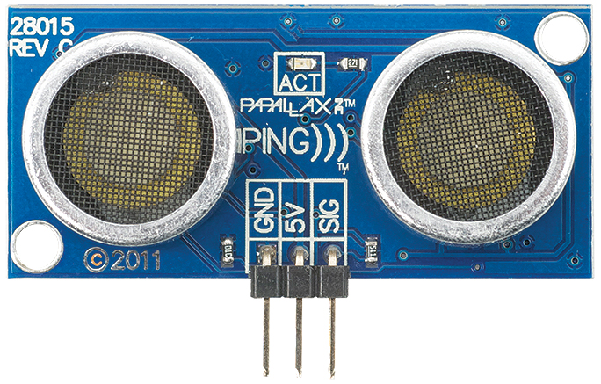
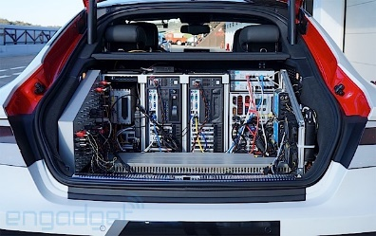
Tradd

Slide 25
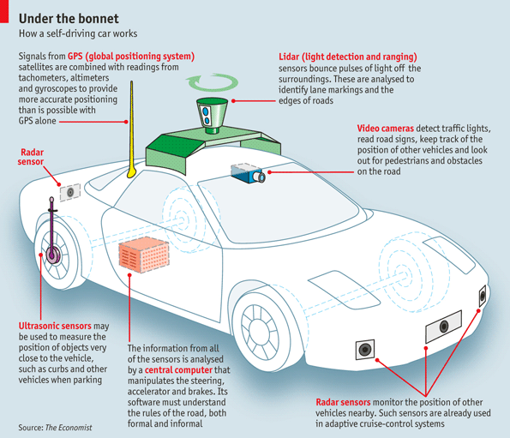

Slide 26
Bibliography
Harris, M. (2016, January 12). Google reports self-driving car mistakes: 272 failures and 13 near misses. Retrieved from https://www.theguardian.com/technology/2016/jan/12/google-self-driving-cars-mistakes-data-reports
Ravindra, S. (n.d.). The Machine Learning Algorithms Used in Self-Driving Cars. Retrieved from http://www.kdnuggets.com/2017/06/machine-learning-algorithms-used-self-driving-cars.html
Gates, G. Granville, K. Markoff, J. Russell, K. Singhvi, A. (2016, December 14). The Race for Self-Driving Cars. Retrieved from https://www.nytimes.com/interactive/2016/12/14/technology/how-self-driving-cars-work.html?_r=0
Silver, A. (2017, July 5) (n.d.). New work: Algorithms to give self-driving cars 'impulsive' human 'ethics'. Retrieved from https://www.theregister.co.uk/2017/07/05/selfdriving_algorithms_that_make_ethical_decisions_based_on_impulse/

Slide 27
Programming
Ultrasonic sensor's API.
An application program interface (API) -
software routines, protocols, and tools
Programmer writes set of instructions API
Compiled by central processing unit.

Slide 28
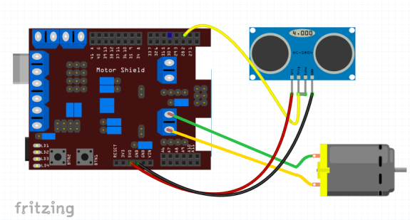
CPU
Directions uploaded on to the CPU
CPU commands ultrasonic sensor
Peripheral executes instructions
The CPU is connected through ports
Input from peripherals
Output from car

Slide 29
Data
CPUs have registers that hold bytes.
1,073,741,824 bytes per second.
In 1998 $228.00. Now $0.88.
1 megabyte = 1024 gigabytes.
1 terabyte = 1024 megabytes.
1 petabyte = 1024 terabytes.

Slide 30
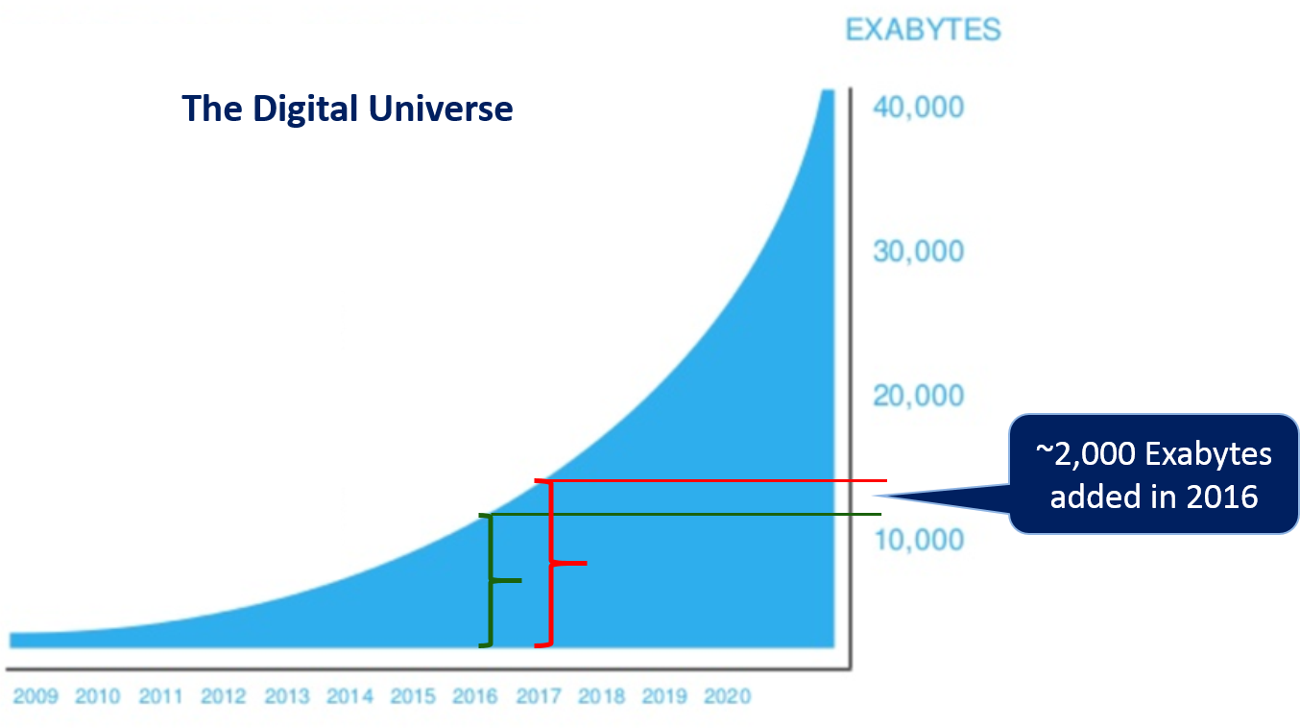
Data
Collect 2 petabytes per year.
1 petabyte ≈ 13.3 years of HDTV video
2 petabytes ≈ 10 billion photos on Facebook
50 petabytes ≈ all written works of mankind
An exabyte ≈ 1024 petabytes
Represented by the function
F(t) where t is time is
F(t)=At^x
X is a variable that is unknown

Slide 31
Bibliography
Araya, D. (2017, February 5). Self-driving cars will soon be everywhere—but you may not own one. Retrieved from https://singularityhub.com/2017/02/05/what-happens-when-self-driving-is-as-common-as-cruise-control/
Campbell, P., & Waldmeir, P. (2017, January 10). Google keeps self-driving cars offline to hinder hackers. Retrieved from https://www.ft.com/content/8eff8fbe-d6f0-11e6-944b-e7eb37a6aa8e
Condliffe, J. (2017, January 10). Why some autonomous cars are going to avoid the Internet - MIT Technology Review. Retrieved from https://www.technologyreview.com/s/603339/why-some-autonomous-cars-are-going-to-avoid-the-internet/
Greenberg, A. (2017, April 12). Charlie Miller on why self-driving cars are so hard to secure from hackers | WIRED. Retrieved from https://www.wired.com/2017/04/ubers-former-top-hacker-securing-autonomous-cars-really-hard-problem/
Igbenoba, A. (2016, November 10). Autonomous vehicles and the Internet of Things | Information Counts. Retrieved from https://informationcounts.com/autonomous-vehicles-and-the-internet-of-things/
Leibert, F. (2017, June 14). The most revolutionary thing about self-driving cars isn’t what you think | World Economic Forum. Retrieved from https://www.weforum.org/agenda/2017/06/the-most-revolutionary-thing-about-self-driving-cars-isn-t-what-you-think/

Slide 32
Abstraction
p=The car is done.
q=The software works.
r=This project is about cars.
“The car is done if and only if the software works.”
p<-->q
p | q | p | ← → | q
T | T | T | T | T
T | F | T | F | F
F | T | F | F | T
F | F | F | T | F

Slide 33
r→(p^q) = car if car done and software
r→(pvq) = car if car done or software
¬r→(p^q) = not car if car done and software
r→ ¬(p^q) = about cars if not car and software
r→(¬pv¬q) = car if not car or not software
Tesla not done and not software
r→(¬pv¬q) r→ ¬(p^q) DeMorgan's Law
Project on car and not car
r^¬r

Slide 34
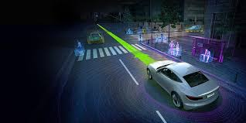
Software structure
- Network interface.
- Communication network with server.
- Monitors vehicles and surroundings
- Use project specific functions
- Manual override interrupts

Slide 35
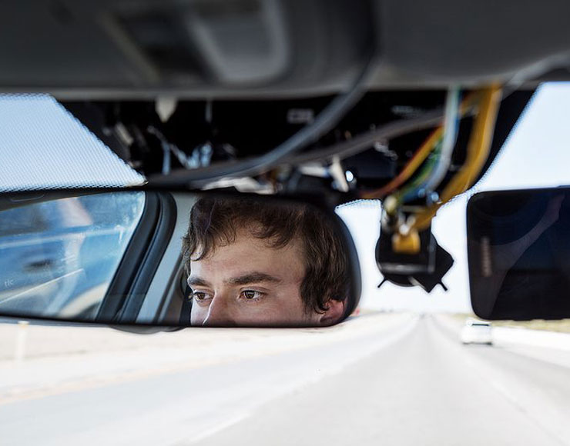
Abstraction
Not available to general public
-expensive
-just not being sold
Genius inventor George Hotz
Built one in two months
-made it cheap
-software available open source
https://github.com/commaai/openpilot

Slide 36
Who Invented Cars?
Troubling interface
Components difficult to use
Apple-made car interface
Windshield wipers easy to use
https://comma.ai/
Uses driving applications
Automation would be welcomed

Slide 37
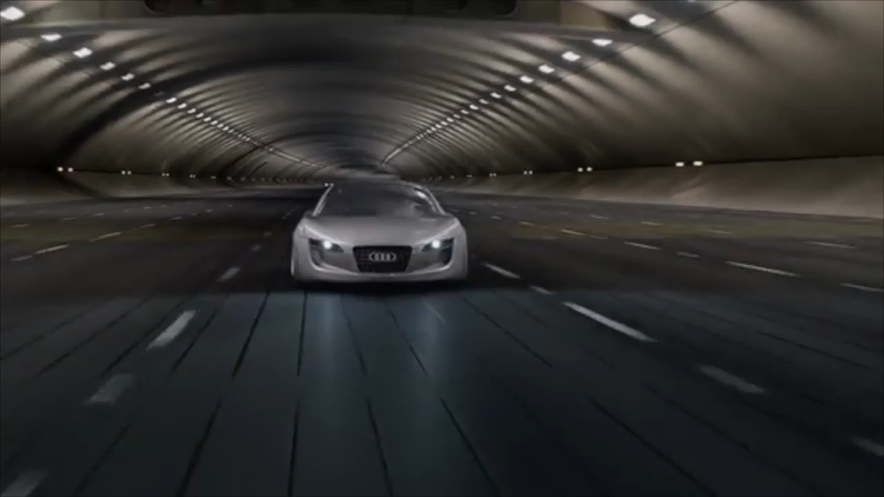
Ethical questions emerge
tradition/culture, safety, affordability, privacy
What are levels of automation?
Level 4 is fully autonomous Level 2 is Tesla and OpenPilot

Slide 38
Bibliography
8 Ways Self-Driving Cars Will Drastically Improve Our Lives.(2016, December 14). Retrieved from Business Insider: http://www.businessinsider.com/how-driverless-cars-will-change-lives-2016-12/#thousands-of-lives-will-be-saved-each-year-1 ​
Business Insider Data Representation. Online Image. (2017, September 10).
Retrieved from http://www.businessinsider.com/research. Self-Driving Car Shipment Forecast
Giaimo, F. (2017, September 10). Design Criteria to Architect Continuous Experimentation for Self-Driving Cars. Retrieved from https://arxiv.org/pdf/1705.05170.pdf
The Economist Online Image. (2017, September 10). Under the Bonnet How a Driverless Car Works. Retrieved from https://www.economist.com/blogs/economist-explains/2013/04/economist-explains-how-self-driving-car-works-driverless

Slide 39
Impact on Society
Potential safety issues
4-5 million jobs lost
Thousands of lives saved every year
Less congestion on roads
Increase in productivity

Slide 40
Bibliography
Ashley, J. (2017, January 1). The driverless car revolution isn’t just about technology – it’s about society too. Retrieved from The Guardian: https://www.theguardian.com/commentisfree/2017/jan/01/driverless-cars-boon-bane-coming-down-fast-lane
Giarratana, C. (2016, October 3). Automation Replacing Human Workers. Retrieved from Safety Resource Center: https://www.trafficsafetystore.com/blog/self-driving-cars-economic-impact/
Marshall, A. (2017, June 3). Robocars Could Add $7 Trillion to the Global Economy. Retrieved from Wired: https://www.wired.com/2017/06/impact-of-autonomous-vehicles/
Newcomb, D. (2016, October 13). Obama Weighs In On Societal And Economic Impact Of Self-Driving Cars. Retrieved from Forbes: https://www.forbes.com/sites/dougnewcomb/2016/10/13/obama-weighs-in-on-societal-and-economic-impact-of-self-driving-cars/#2547e5ce68d8
Thompson, K. (2016, December 14). 8 ways self-driving cars will drastically improve our lives. Retrieved from Business Insider: http://www.businessinsider.com/how-driverless-cars-will-change-lives-2016-12/#thousands-of-lives-will-be-saved-each-year-1

